Slide 1


Slide 2

Group 4 Project 4:
Talieh, Michael, Simon and Rohit
Bank Churn Analysis and Prediction
Using Machine Learning Models

Slide 3
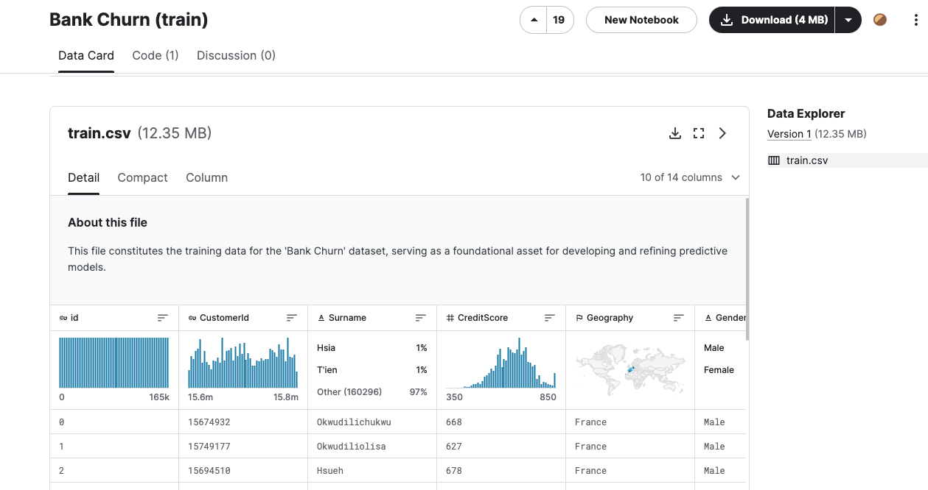
Dataset:
kaggle.com/datasets/harshitstark/bank-churn-train
Attributes of Dataset:
Credit Score
Geography
Gender
Age
Tenure
Balance
Number of Products
Has Credit Card or not?
Active Member or not?
Estimated Salary
Did they Exit or not?

Slide 4
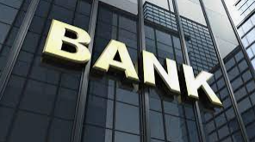

Target Audience
Banking Institutions
Marketing and Customer Retention Teams
Data Analysts and Data Scientists
Business Decision Makers

Slide 5

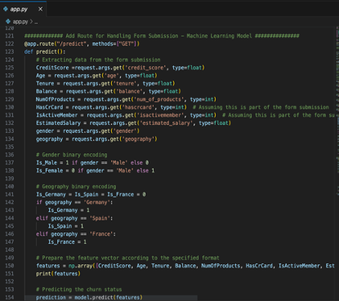
Flask web application
Integrates with a PostgreSQL database hosted on AWS (Neon PostgreSQL instance).
Utilizes a pre-trained machine learning model for analysis.
Enables user input of customer data via a web interface.
Predicts customer loyalty based on the input data.

Slide 6

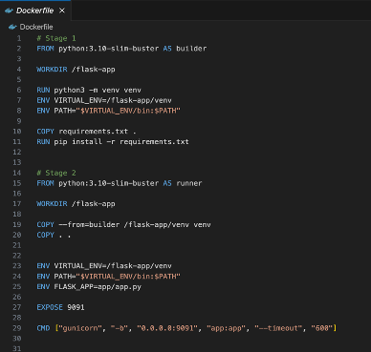
Docker
Technical Advantages of Docker
Isolation
Portability
Efficiency
Development Productivity

Slide 7

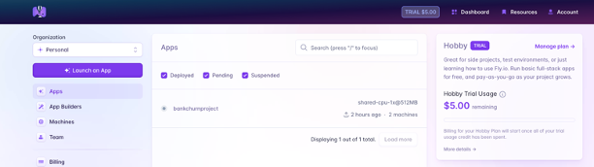
Fly.io
Technical Advantages of Docker
Low Latency: Fly.io's network spans across the globe, enabling our application to run closer to our users, no matter where they are.
Easy Scaling: As the demand for our web application grows, Fly.io can automatically allocate more resources or distribute the load across its global network.
Simplified Deployment Process its developer-friendly tools and provides documentation.

Slide 8
Machine Learning Models
Logistic Regression
Random Forest
XGBoost
Neural Networks

Slide 9
Logistic Regression Model
Good for binary classification tasks (True/False or 0/1)
Data Cleansing
Accuracy score: 0.78
Poor accuracy of predicting customers that are not loyal
0.19 f1 score (1)

Slide 10
Random Forest Model
Find relationships with non-linear data by
Create a random subset of features and multiple decision trees
Accuracy score: 0.85
Improvement in predicting customers that are not loyal
0.61 f1 score (1)

Slide 11
XGBoost Model
Learn from previous decision trees based on gradient
Gradient Boosting to minimise loss in training data
Hyperparameters to optimise model
Accuracy score: 0.86
Slight improvement in predicting customers that are not loyal
0.64 f1 score (1)

